Slide 1

HR DATA ANALYSIS Internship @Psyliq By Pratik Hiremath

Slide 2
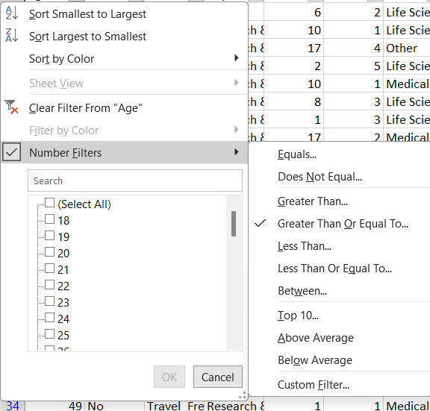
1. Using Excel, how would you filter the dataset to only show employees aged 30 and above?

Slide 3
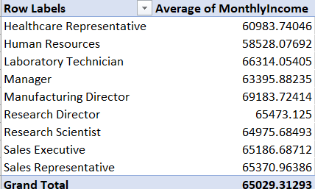
2. Create a pivot table to summarize the average Monthly Income
by Job Role.

Slide 4
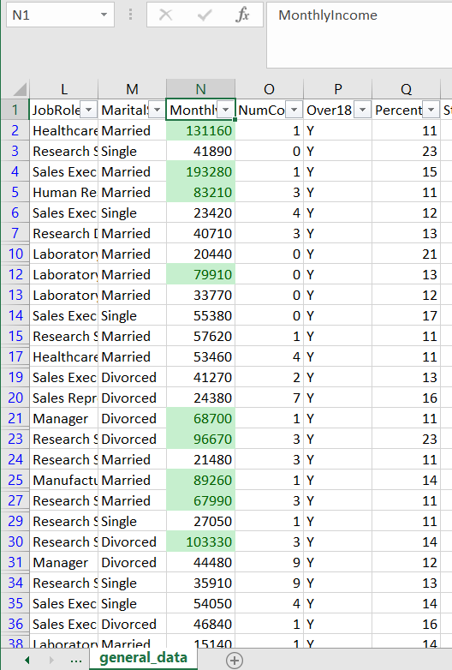
3. Apply conditional formatting to highlight employees with Monthly Income
above the company's average income.

Slide 5
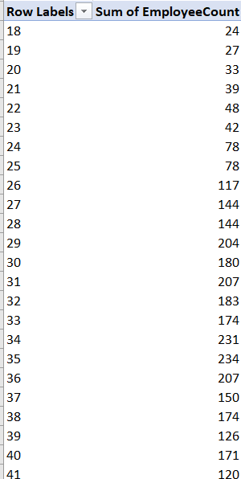
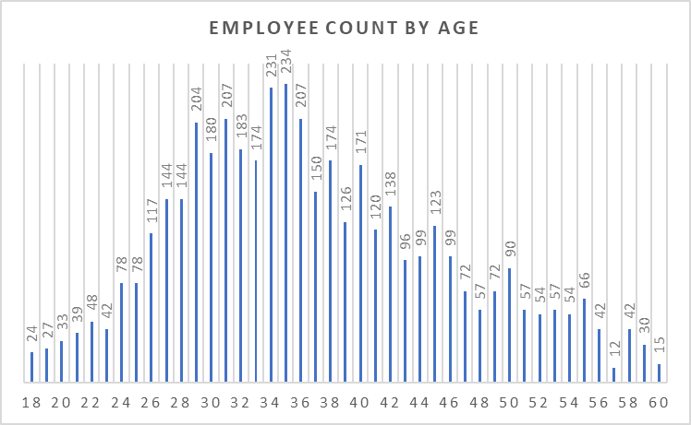
4. Create a bar chart in Excel to visualize the distribution of employee ages.

Slide 6
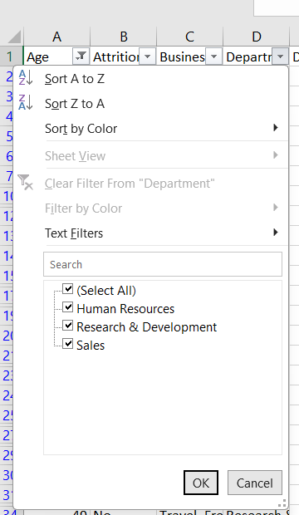
5. Identify and clean any missing or inconsistent data in the "Department"
column.

Slide 7
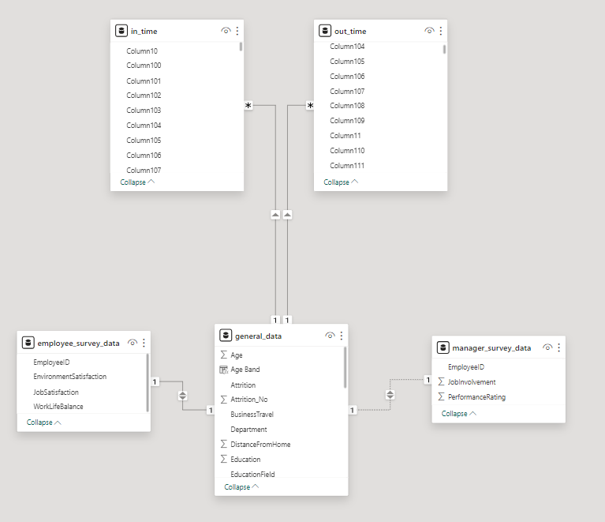
6. In Power BI, establish a relationship between the "EmployeeID" in
the employee data and the "EmployeeID" in the time tracking data.

Slide 8
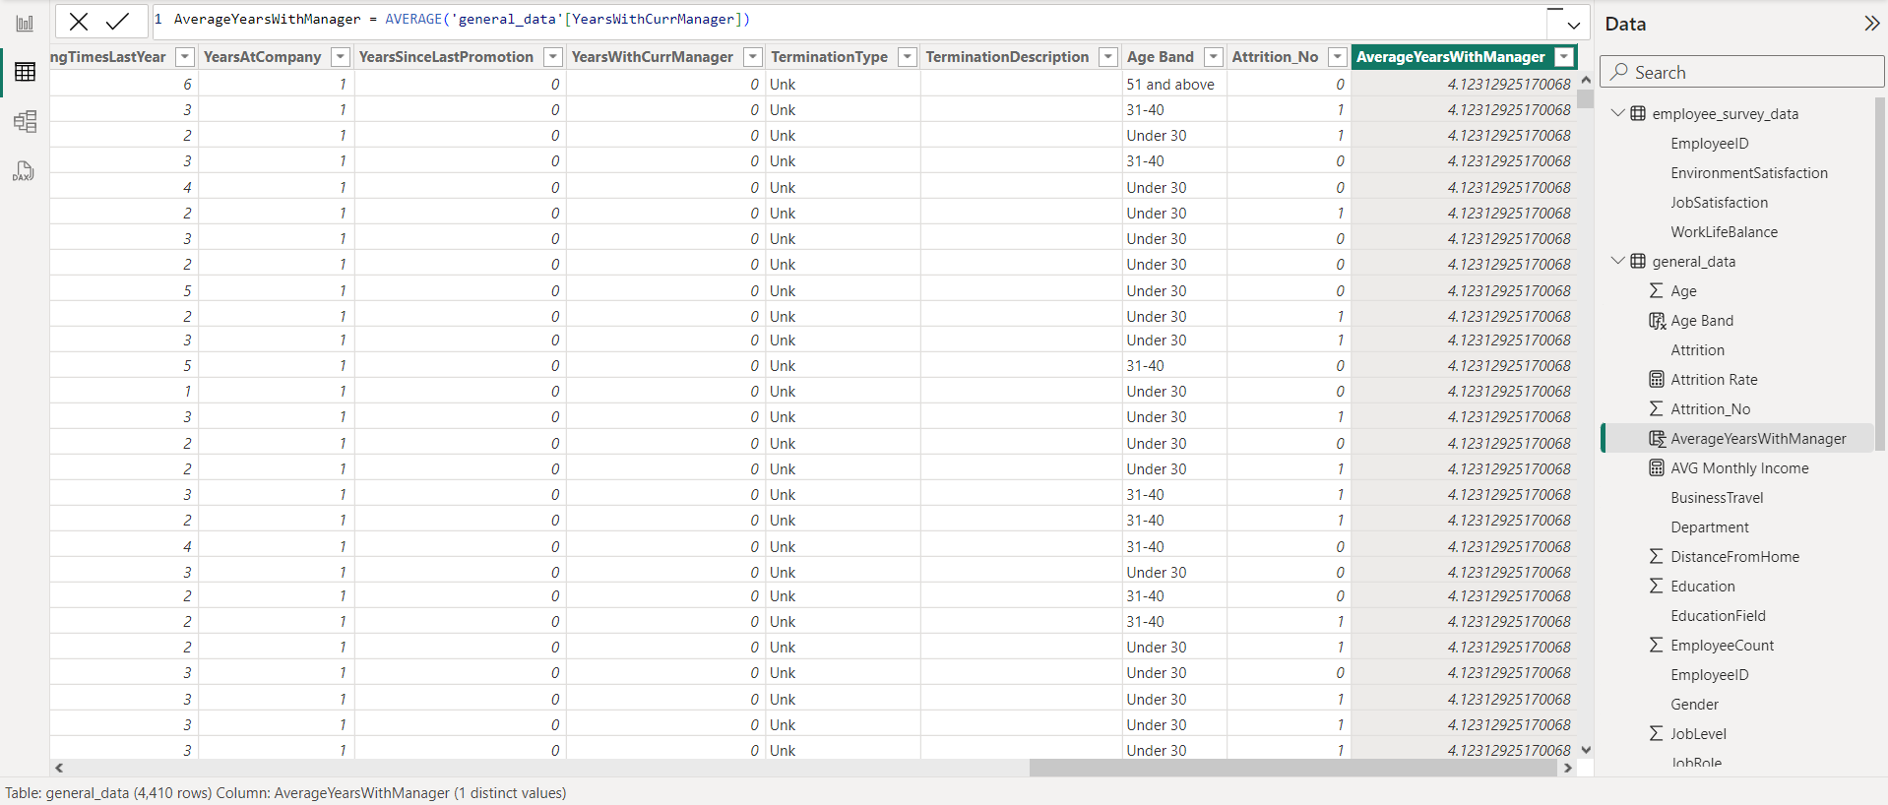
7. Using DAX, create a calculated column that calculates the average
years an employee has spent with their current manager.

Slide 9
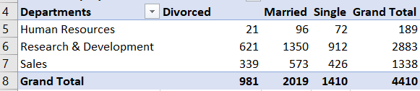
8. Using Excel, create a pivot table that displays the count of employees
in each Marital Status category, segmented by Department.

Slide 10
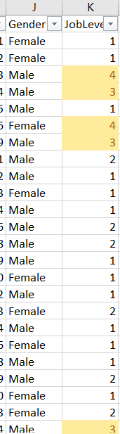
9. Apply conditional formatting to highlight employees with both
above-average Monthly Income and above-average Job Satisfaction

Slide 11
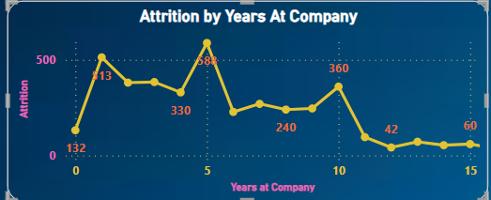
10.In Power BI, create a line chart that visualizes the trend of Employee
Attrition over the years.

Slide 12
11. Describe how you would create a star schema for this dataset, explaining the benefits of doing so.
What is a Star Schema?
A star schema is a data warehouse modeling technique that organizes data into a central fact table surrounded by dimension tables. The fact table contains quantitative data (facts), and dimension tables store descriptive attributes related to the facts. This structure resembles a star when visualized, with the fact table at the center and dimension tables radiating out like star points.
Benefits of Star Schema:
Simplified Queries: It simplifies query complexity as most queries involve joining the fact table with one or more dimension tables, leading to faster query performance.
Improved Performance: Star schema's denormalized structure and optimized join paths enhance query performance, making analytical processing more efficient.
Scalability: It supports scalability by allowing easy addition of new dimension tables without impacting existing data or query performance.
Ease of Use: Provides a user-friendly structure for business analysts and end-users to navigate data intuitively, facilitating easier reporting and analysis.
Enhanced Data Integrity: Reduces data redundancy and ensures data integrity through clear relationships between the fact table and dimension tables.
Optimized Storage: Requires less storage space compared to other schemas like snowflake schema due to denormalization and fewer join operations.

Slide 13
12. Using DAX, calculate the rolling 3-month average of Monthly Income for each employee.
Rolling Avg = (AVERAGE(‘general_data’[MonthlyIncome]), DATESINPERIOD( ‘YourTableName’[Date], LASTDATE(‘YourTableName’[Date]), -3, MONTH )

Slide 14
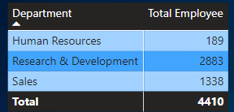
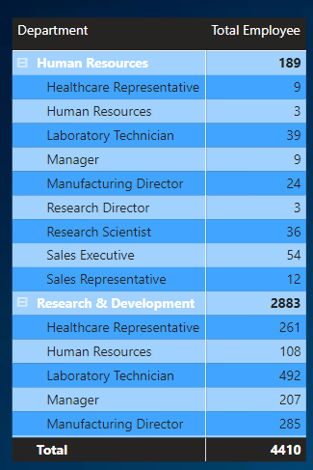
13. Create a hierarchy in Power BI that allows users to drill down from Department to Job Role to further narrow their analysis.

Slide 15
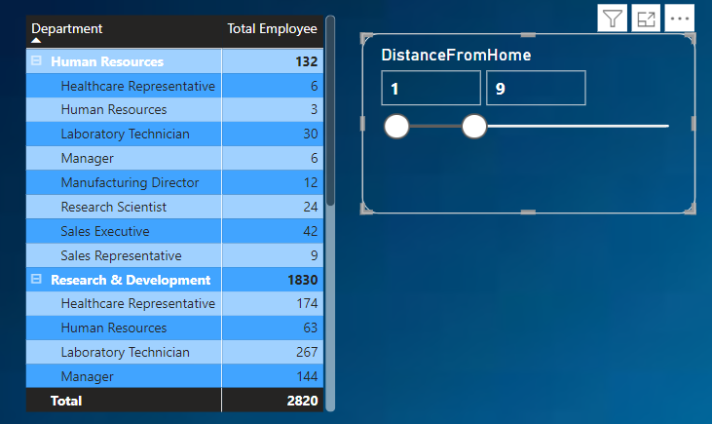
14. How can you set up parameterized queries in Power BI to allow users to filter data based on the Distance from Home column?

Slide 16
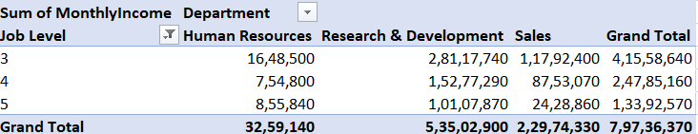
15. In Excel, calculate the total Monthly Income for each Department, considering only the employees with a Job Level greater than or equal to 3

Slide 17
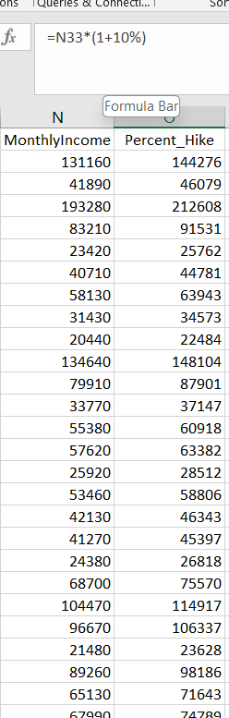
16. Explain how to perform a What-If analysis in Excel to understand the impact of a 10% increase in Percent Salary Hike on Monthly Income.

Slide 18
17. Verify if the data adheres to a predefined schema. What actions would you take if you find inconsistencies?
When dealing with inconsistencies in data:
Ensure Data Normalization: Verify if the data follows normalization principles; if not, normalize the dataset to eliminate anomalies and improve data consistency.
Validate Column Data Types: Review each column in the dataset to confirm its data type alignment with the intended use and analysis requirements.
Validate Table Relationships: Check the relationships between tables to ensure data integrity and coherence, especially in databases with multiple interconnected tables.
Data Transformation: Transform the dataset as needed to address any inconsistencies or discrepancies found during the validation process.
Handle Null Values Appropriately: Replace null values with suitable alternatives such as zeros, means, or other values specified by the client or based on data analysis needs.

